Slide 1
WHAT CAN THE ENERGY AND WATER INDUSTRIES LEARN FROM EACH OTHER?
Presented by
Stephen P. King
Commissioner, Productivity Commission
Sydney, 27 October 2017

Slide 2
Issues
Industry structure and competition
Pricing
Investment
2

Slide 3

Industry structure and competition

Slide 4
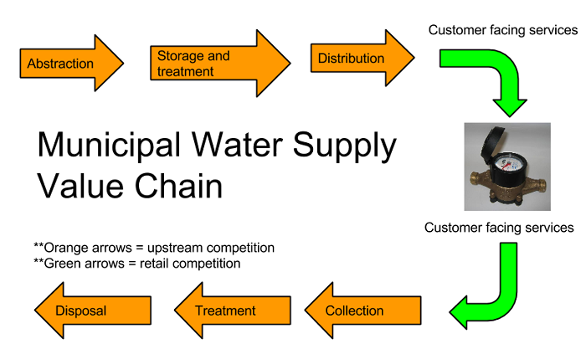

Slide 5
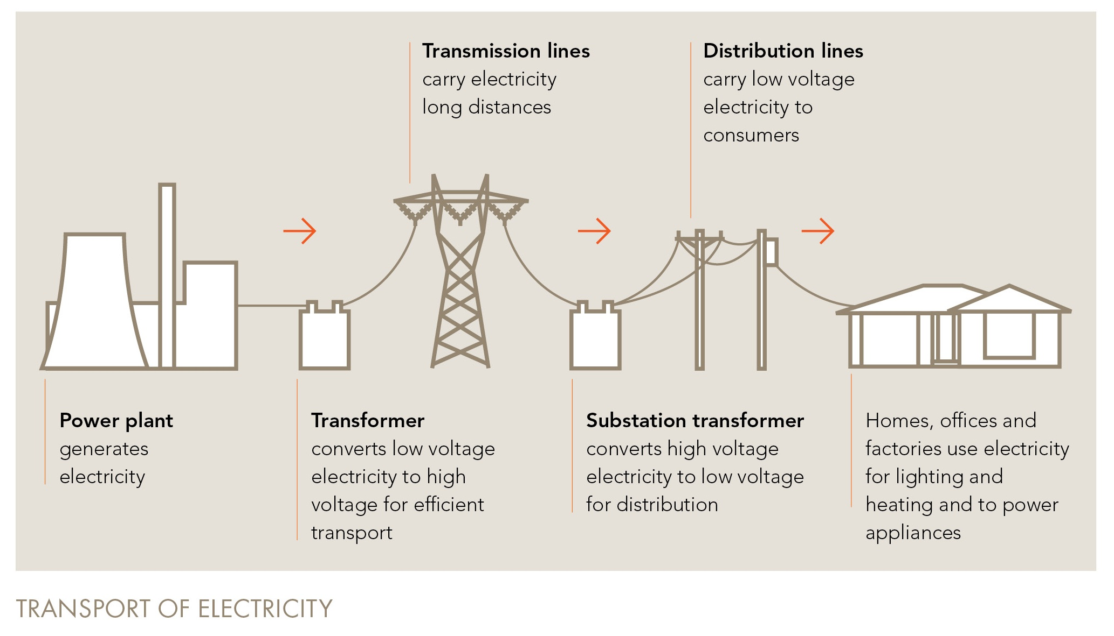

Slide 6
Structure and the economics of natural monopolies
determines where competition is possible
What is the nature of competition at each relevant
level and how is the market structured?
Industry structure and competition

Slide 7
Source: ABS, CME analysis

Slide 8
Structure and the economics of natural monopolies
determines where competition is possible
What is the nature of competition at a level and how
is the market structured?
What is the nature of competition at each relevant
level and how is the market structured?
How is competition facilitated through access?
What level of vertical integration is allowed?
Industry structure and competition

Slide 9
Pricing

Slide 10

Pricing at what level of the supply chain?
Pricing for access
Pricing

Slide 11
Regulated network charges account for much of the end-user price increase (in states where networks owned by governments)
Government owned
Privately owned
Source: regulatory decisions, CME analysis

Slide 12
Pricing at what level of the supply chain?
Pricing for access
Why the components of prices matter
Pricing for system augmentation
Pricing

Slide 13
Investment

Slide 14
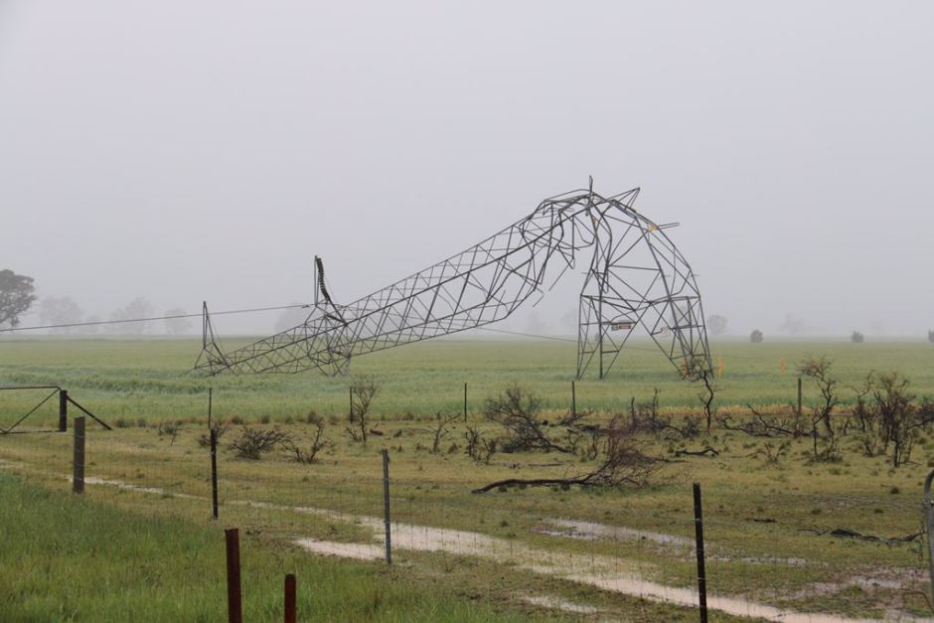
Can investment just be ‘left to the market’?
Does this depend on the ‘design’ of the market?
What happens when …. happens?
Investment

Slide 15

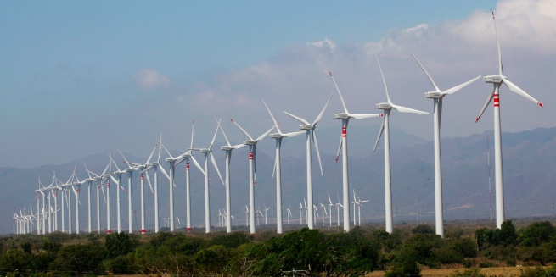
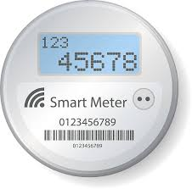

And so much more …

