Slide 1
The Solution to Public Transit Inefficiencies in the United States: Widespread Adoption of Autonomous Vehicles
Clifford Winston
The Brookings Institution

Slide 2
Outline
Stylized facts about United States transit systems
Demand inefficiencies
Production inefficiencies
Technological change
Political forces
Future developments

Slide 3
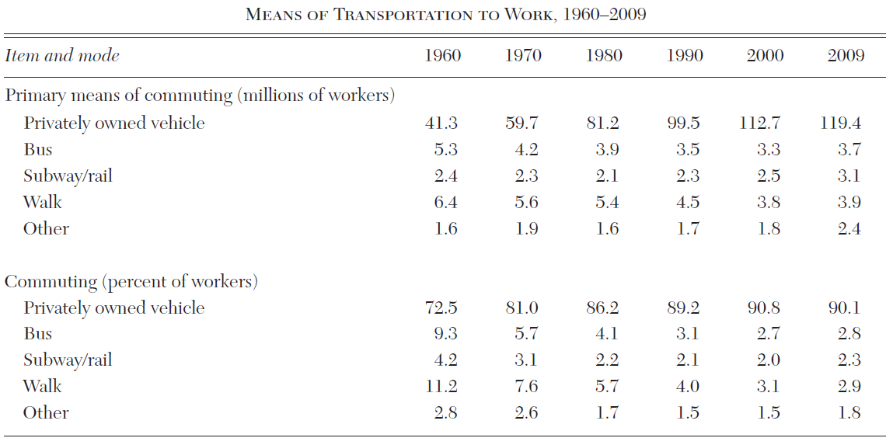
Stylized Facts: Mode Shares

Slide 4
Stylized Facts: Mode Shares
Transit’s mode share (bus and rail) of commutes to work was 13.5 percent in 1960. By 2009, its share was roughly 5 percent. Its share of non-work trips is even lower.
In 2008, transit ridership rose to its highest level since the 1950s with the U.S. economy in decline. But its financial situation worsened because fares account for only 20 to 50 percent of revenues and its main source of funds, state and local tax receipts, has declined
The entry of Uber and Lyft and other forms of shared transportation are cutting into transit shares as are recent debacles to be discussed.

Slide 5
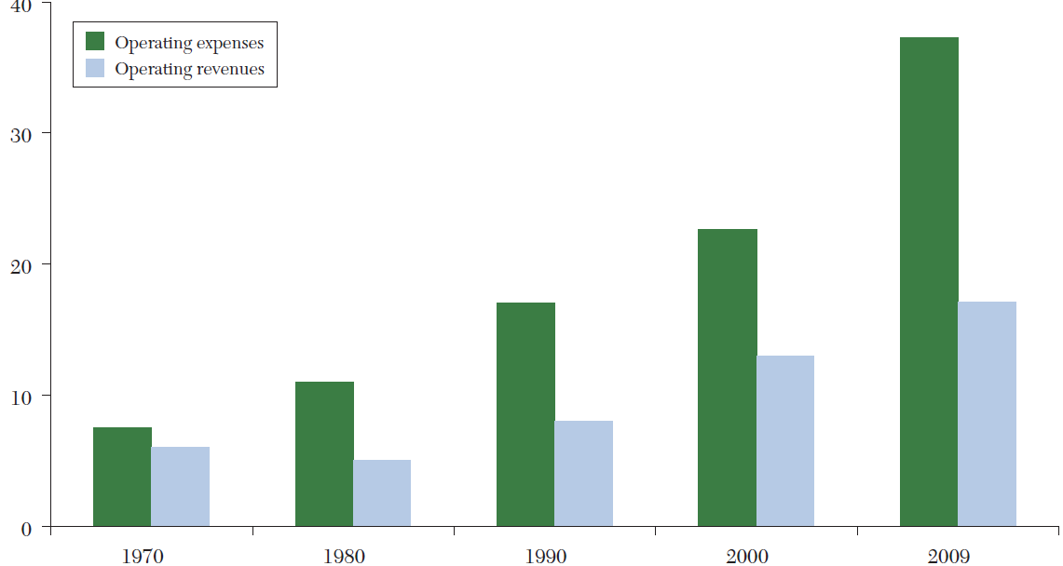
Stylized Facts: Operating Costs and Revenues

Slide 6
Stylized Facts: Financial Condition
Service costs have soared creating deficits covered by taxpayers. By 2009, annual operating expenses were nearly $40 billion, and roughly twice operating revenues.
Capital subsidies add another $15 billion, bringing total subsidies to more than $30 billion.
At the same time, rail transit assets are in poor condition and need capital for repairs
Amazingly, new rail systems and extensions of existing ones continue to be built.

Slide 7
Summary
The combination of shrinking mode share and growing subsidies raises the question of whether public transit in the United States is even socially desirable—that is, social benefits, including lower externalities from auto, exceed social costs, including subsidies.
I have found that rail transit is generally not socially desirable and that bus social desirability is highly questionable.

Slide 8
Demand Side Inefficiencies: Pricing and Service
More than 80 percent of public transit systems charge a uniform price that ignores the duration and time of a trip. Even those fares that vary by time of day and distance are kept below marginal cost.
The household income of transit users is above the average income of US households
Certain commuters are provided with transit service at no charge and others, e.g., myself, get additional tax subsidies

Slide 9
Demand Side Inefficiencies cont.
The frequency of trips is not determined by optimization—that is, balancing marginal costs and benefits. The result is that frequency is excessive.
Low load factors, less than 20 percent, are attributable to excess frequency and standardized vehicles, which do not alter capacity in response to demand.
Route coverage is not responsive to demographic changes

Slide 10
Optimal Service Policies
Raise price to marginal cost
Reduce service frequency so the net benefits of transit service are maximized
The problem is demand will spiral downward
Second best arguments do not help much and first-best pricing of auto does little to help transit demand

Slide 11
Production Inefficiencies
Federal regulations increase the cost of capital that is used to provide service (e.g., Buy American provisions, EPA Retrofit/Build requirements)
Formula grants distort investment decisions to obtain capital subsidies
Labor expenses are inflated by powerful unions and the 1964 FTA act that makes it extremely expensive to fire a transit employee

Slide 12
Production Inefficiencies (cont)
Excessive highly paid administrative positions raise labor costs
Charles Lave estimated that if labor productivity had remained constant since 1964, bus operating costs in 1990 would have been 40 percent lower and most of the bus transit operating deficit would have been eliminated without raising fares
Transit subsidies encourage inefficiencies to flourish and productivity to decline

Slide 13
Spending Inefficiencies
The costs of building new rail systems often exceed expectations, while ridership levels tend to be lower than expected
  New Honolulu system, 40% completed, needs a $2.4 billion bailout from new hotel taxes
  Ridership on extension of DC Metro to Dulles airport is below forecast and adding to deficits
Cost overruns persist after systems are built
  NYC system is in dire straits despite $billions
Transit investments/expenditures are not based on cost-benefit analysis
  $1 billion subsidy for new purple line in MD.

Slide 14
Slow Rate of Technological and Operational Advance
NextBus, which offers satelite-provided bus location information, has been slow to be adopted
Buses equipped with GPS systems, could improve service times and reliability
Greater use of mini-buses could improve efficiency
The possibility of profitable paratransit and jitney service should be explored
Transit systems are prevented from providing non-transit services
Autonomous operations will be resisted

Slide 15
Political Forces Inhibiting Constructive Change in Transit
Planners
Suppliers of labor and capital
Civic boosters
Congress
Public
New Projects—will not take NO for an answer

Slide 16
Transit Outside of the US
Some systems are better aligned with population density and are more competitive with auto than are US systems
Some systems offer transit and non-transit services, which increases revenue
Labor costs are better controlled
Pricing is better aligned with costs

Slide 17
Future Developments
Privatization faces exceptional challenges in the United States. I would like to see experiments in bus and possibly rail transit, but there will be strong political resistance
Transit does face serious challenges from shared vehicles.
However, the major threat is from autonomous vehicles because they would effectively provide personalized transit service at low cost

Slide 18
Future Developments Continued
It is expected that most people will subscribe but not own autonomous vehicles; thus, they will largely eliminate the capital costs of ownership.
Operating costs will be reduced by less congestion, but user charges may be applied
Still the cost and convenience of autonomous vehicles is likely to eventually eliminate public transit service in the U.S. and its large subsidies

