Slide 1
Optimising transport to recognise external benefits
Discussant comments
Mike Smart, Chief Economist
27 October 2017

Slide 2
Mode shares compared: Sydney v USA
Source: NSW Bureau of Transport Statistics and the Brookings Institution

Slide 3
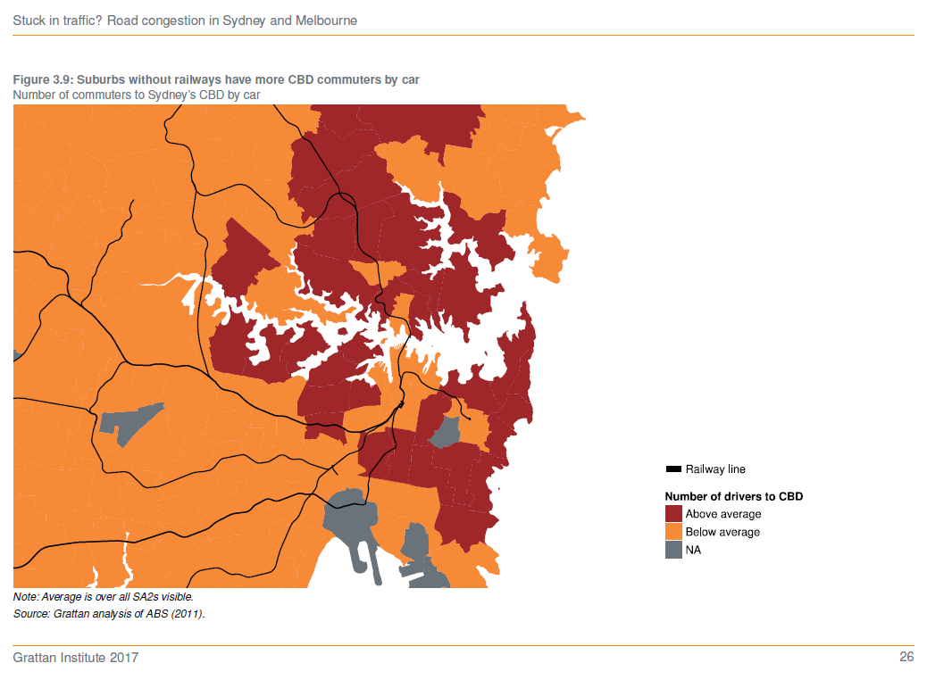
Where available, trains substitute for cars

Slide 4
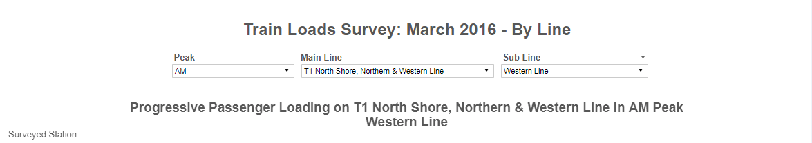
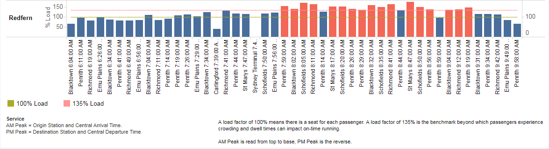
But trains also have a capacity problem

Slide 5
How we estimate socially optimal fares
Value
Social welfare
MEB
MFC
MSC
Social optimum
D = MSC
Government subsidy
P*
D
Q*
Quantity

Slide 6
For now, pricing signals can help
Source: IPART

Slide 7
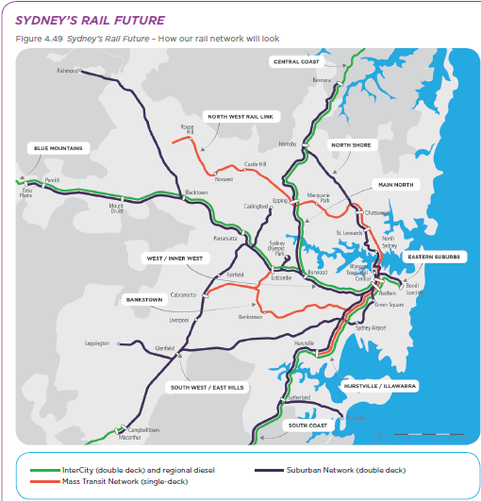
Long-term, widen rail system bottleneck

Slide 9
Mode shares compared: Sydney v LA city
Source: NSW Bureau of Transport Statistics and Los Angeles Department of Transportation

Slide 10
Modal choice by income

Slide 11
Modal choice by income
(including non-travelers)

