Slide 1
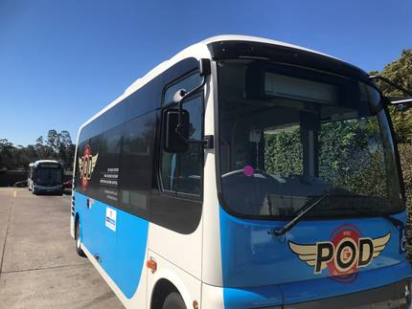
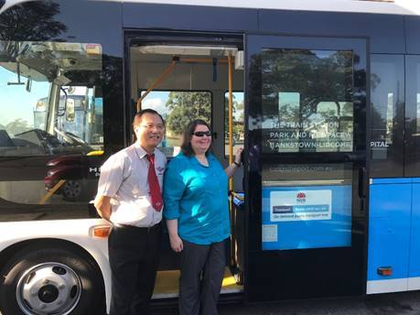
Competition For On-Demand and Point to Point Transport
Matt Threlkeld, Executive Director, BusNSW
IPART 25th Anniversary Conference
27 October, 2017

Slide 2
Overview
The “On-Demand Bus” Perspective
Where does On-Demand fit in the transport mix?
Provision of On-Demand Bus Services
TfNSW Pilots and Future Bus/PT Contracts
Fixed Route/Timetable v On-Demand
On-Demand Bus Services – To Consider!

Slide 3
The “On-Demand Bus” Perspective
On-Demand Buses – motor vehicle > 8 seats
Bus industry has dabbled in “on-demand”
Resurgence based on technology & rideshare
JVs between bus operator and app developer
Opportunity to include in Bus/PT contracts
Can market provide on commercial basis?

Slide 4
Where does On-Demand Fit?
 | Fixed Route Bus | On Demand Bus | Point to Point & Taxi (Booked) | Taxi (Rank and Hail)
Booking | Not Needed | Needed | Needed | Not needed
Time Schedule | Operate according to a timetable | Customer designates time | Customer designates time | Next available at location
Route & Stops | Buses stop at designated stops along a fixed route | Most efficient route with a group of people travelling in same direction | Travel the shortest distance between two desired points | Travel the shortest distance between two desired point
Fare ($) | Low-cost | In-between that of a fixed route bus and PtP/Taxi | High-cost (Dynamic -/+ Taxi Rank & Hail) | High-cost (Max Fare - TfNSW)

Slide 5
Provision of On-Demand Bus Services
Bus Type | Contracted | Market
Bus 9-12 Seats including Driver (NSW Point to Point Legislation) | Regulated based on vehicle size (Levy ?) Operated under contract (TfNSW) Greater variations available - full or partial on-demand Where subsidised = lower fare ($) Price advantage over commercial on-demand | Regulated based on vehicle size (Levy ?) Operated on commercial basis Limited on-demand variations No subsidy = higher [dynamic?] fare ($) Difficult to compete with contracted on-demand
Bus 13+ Seats including Driver (NSW Passenger Transport Legislation – Bus Operator Accreditation Scheme)

Slide 6
TfNSW Pilots & Future Bus/PT Contracts
Dec 2016 TfNSW requests EOI for pilots to incubate on-demand bus services
What role should government play in subsidising personalised transport?
When to convert fixed route & timetable to on-demand service under bus/PT contract
How to procure on-demand bus services

Slide 7
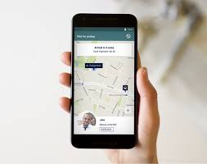
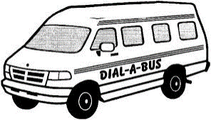
Fixed Route/Timetable v On-Demand
?
Fixed route and timetable
Area based
Low patronised feeder service
On-demand
Cost to government, customer benefit & externalities

Slide 8
On-Demand Bus Services - to Consider!
Equity of service type between communities
Community acceptance of on-demand bus services
Fares & ticketing – how to integrate with mass transit (Opal & Rural/Regional), and MaaS model
Greenfield experiments – using O-D to plan fixed route
Compliance with disability standards for accessible PT
On-demand autonomous buses!

Slide 9
Thank You
BusNSW
@BusNSW

