Slide 1
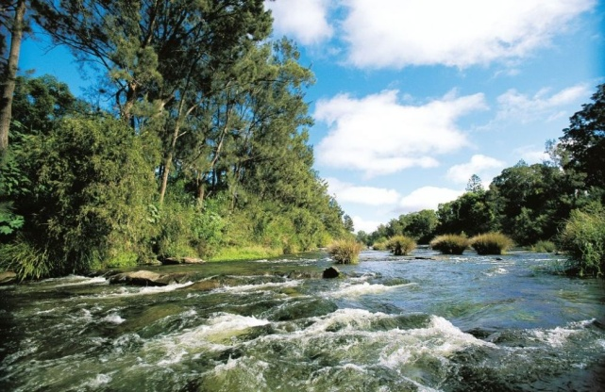
Special Rate Variation
Richmond Valley Council
Prepared by: Micromex Research
Date: December 2013

Slide 2
Background

Slide 3
Methodology & Sample
Interviewing
A random telephone survey of 400 residents was conducted from 2nd to 5th December 2013.
Interviewing was conducted in accordance with IQCA (Interviewer Quality Control Australia) Standards and the Market Research Society Code of Professional Conduct. Where applicable, the issues in each question were systematically rearranged for each respondent.
Sampling Size Implication
A random community sample size of 400 provides a maximum sampling error of plus or minus 4.9% at 95% confidence.
This means that if the survey was replicated with a new universe of n=400 Richmond Valley residents, 19 times out of 20 we would expect to see the same results, i.e. +/- 4.9%.
Therefore, the research findings documented in this report should be interpreted by Richmond Valley Council and IPART as not just the opinions of 400 residents, but as an accurate and robust measure of the entire Richmond Valley Council community’s attitudes.
The phone survey will provide Richmond Valley Council with a robust and statistically valid measure of community response to the proposed SRV program

Slide 4
Questionnaire Flow
The questionnaire, of approximately 10 minutes in duration, was designed to establish current attitudes and explore community response to the proposed resource strategies
Questionnaire Structure
Q5a. Prior to this call were you aware that Council was potentially seeking to apply for a special rate variation
Q5b. How were you informed of the special rate variation
Q6. How important do you believe it is that Council be allowed to introduce this special rate variation?
Q7. Age group
Q8. Home ownership
Q9. Do you live in a:
Q10. Employment status
Q11. Gender
QA. Confirmation that respondent does not work for Council
Q1. Suburb of residence
Q2. Number of years lived in the area
Q3. How important do you believe it is for Council to implement programs that will provide better infrastructure and service?
READ CONCEPT
Q4. How supportive are you of Council proceeding with this application?
Q4b. Why do you say that?
Q5. How much per week would you be prepared to pay to realise the benefits of this proposal over the next 4 years?
The questionnaire was developed in conjunction with Richmond Valley Council staff

Slide 5
Sample Profile

Slide 6
Sample Profile
Base: n = 400
The sample has been weighted to reflect ABS Census data

Slide 7
Detailed Responses

Slide 8
94% Of Residents Believe It Is At Least ‘Important’ For Council To Implement Programs That Will Provide Better Infrastructure And Services
Q. How important do you believe it is for Council to implement programs that will provide better infrastructure and service?
Mean ratings | Male | Female | Own | Rent
 | 4.49 | 4.56 | 4.52 | 4.54
 | Overall: 4.52
 | 18-34 | 35-49 | 50-64 | 65+
 | 4.55 | 4.45 | 4.52 | 4.57
Scale: 1=not at all important, 5=very important
Base: n = 400
The community wants Council to focus on providing for the LGA

Slide 9
Support of SRV Concept

Slide 10
74% Of Residents Were Aware Of The SRV Application, Most Informed By Council’s Mail Out (84%)
Q. Prior to this call were you aware that Council was potentially seeking to apply for a special rate variation?
Q. How were you informed of the special rate variation?
Base: n = 400
Base: n = 297
There was a high level of awareness that Council was seeking to make an application for an SRV

Slide 11
Concept Statement
Read Concept statement:
Rates are Council’s main source of income for delivering services, and are capped by the State Government. This is usually set to increase at around 3% per annum.
When developing the Community Strategic Plan, Richmond Valley Council recognised that it would not be able to maintain existing service levels in the community without an increase in the Ordinary rate. This is as a result of having to spend more maintaining new assets at a higher standard to meet the needs of our growing community.
As such, in Council’s 10 year financial plan it factored in a rate variation that was in excess of the standard 3% rate peg. Council is proposing to apply to IPART (Independent Pricing and Regulatory Tribunal) for a permanent General rate increase of 12.5% next year and 5.5% per year for the next 4 years after that. This includes the allowed ‘rate peg’ and would account for an annual increase of $1.73 per week or $90 a year next year and 85 cents per week or $44.20 extra per year for each of the next four years for the average residential household.
Note this increase is not applicable to water, sewer or garbage rates.
Projects this increase will fund include the following:
Addressing the backlog in road, park, drainage, public toilet and playground renewals $6,260,000
Improving the Casino, Coraki and Woodburn riverfronts $1,875,000
Implementing job generation initiatives, developing industrial land and WiFi for towns $1,260,000
Major car parking improvements in Casino and Evans Head CBD $1,080,000
Civic pride, cultural and art facilities Casino Riverbank Amphitheatre $870,000
Modern IT systems, better communication to residents $440,000
New skate park in Woodburn and extensions in Casino, and Evans Head $430,000
Better maintenance on drainage, playground equipment and toilet cleaning $400,000
Providing Council traineeships for school leavers $300,000
The purpose of this increase is to ensure the future financial sustainability of the local government area and to ensure that Richmond Valley remains a great place to live.
Residents were given the opportunity to have the statement read multiple times to ensure they felt comfortable that they understood the SRV concept

Slide 12
66% Of Residents Are At Least ‘Somewhat Supportive’ Of Council Proceeding With The Application
Q. How supportive are you of Council’s proceeding with this application? Q. Why do you say that?
Mean ratings | Male | Female | Own | Rent
 | 2.97 | 3.03 | 2.94 | 3.44
 | Overall: 3.00
 | 18-34 | 35-49 | 50-64 | 65+
 | 3.02 | 2.81 | 2.99 | 3.15
Scale: 1=not at all supportive, 5=very supportive
Supportive (40%)
The area's services and facilities need improving | 18%
The community will benefit, so need to assist with funding | 10%
Services and facilities need to be maintained | 5%
Somewhat supportive (26%)
The area's services and facilities need improving | 8%
The increase is too high | 6%
Not supportive (34%)
Council needs to manage their funds better | 12%
Cannot afford a rate rise | 11%
Don’t feel my area would benefit | 10%
Base: n = 400
The community wants Council to focus on providing for the LGA

Slide 13
When Pressed, Many Residents Opted For The Minimum Amount
Q. How much a week would you be prepared to pay to realise the benefits of this proposal over the next 4 years?
Base: n = 400
45% opted to pay less than a dollar per week and 48% nominated paying $1+ per week

Slide 14
Nearly ¾ Of Residents Thought It Was At Least ‘Somewhat Important’ For Council To Be Allowed To Introduce The SRV
Q. Based on what you have been told, how important do you believe it is that Council be allowed to introduce this special rate variation?
Mean ratings | Male | Female | Own | Rent
 | 3.11 | 3.23 | 3.13 | 3.46
 | Overall: 3.17
 | 18-34 | 35-49 | 50-64 | 65+
 | 3.15 | 2.98 | 3.18 | 3.32
Scale: 1=not at all important, 5=very important
Base: n = 400
Residents generally feel it is important for Council be financial secure and that Richmond Valley remains a great place to live

Slide 15
Conclusion

Slide 16
Conclusion
Residents are generally supportive of Council’s application
66% of residents are at least ‘somewhat supportive’ of Council proceeding with the application
A significant number of residents believe that the introduction of a Special Rate Variation is important
73% Of residents thought it was at least ‘somewhat important’ for Council to be allowed to introduce the SRV

Slide 17
Telephone: (02) 4352 2388 Fax: (02) 4352 2117
Web: www.micromex.com.au Email: warren@micromex.com.au

