Slide 1
REVIEW OF home building compensation in NSW
PUBLIC HEARING
Please mute your microphone
Please turn on your camera (webcam)
We’ll start at 2.02 pm
Home Building Compensation Review
29 September 2020

Slide 2
MC – Liz Livingstone, IPART CEO
Welcome – Dr Paul Paterson, Tribunal Chair
Overview of key draft findings and recommendations
Feedback and questions
Closing remarks – Dr Paul Paterson and Liz Livingstone
  [ ]
    [ ]
      [ ]
Agenda

Slide 3
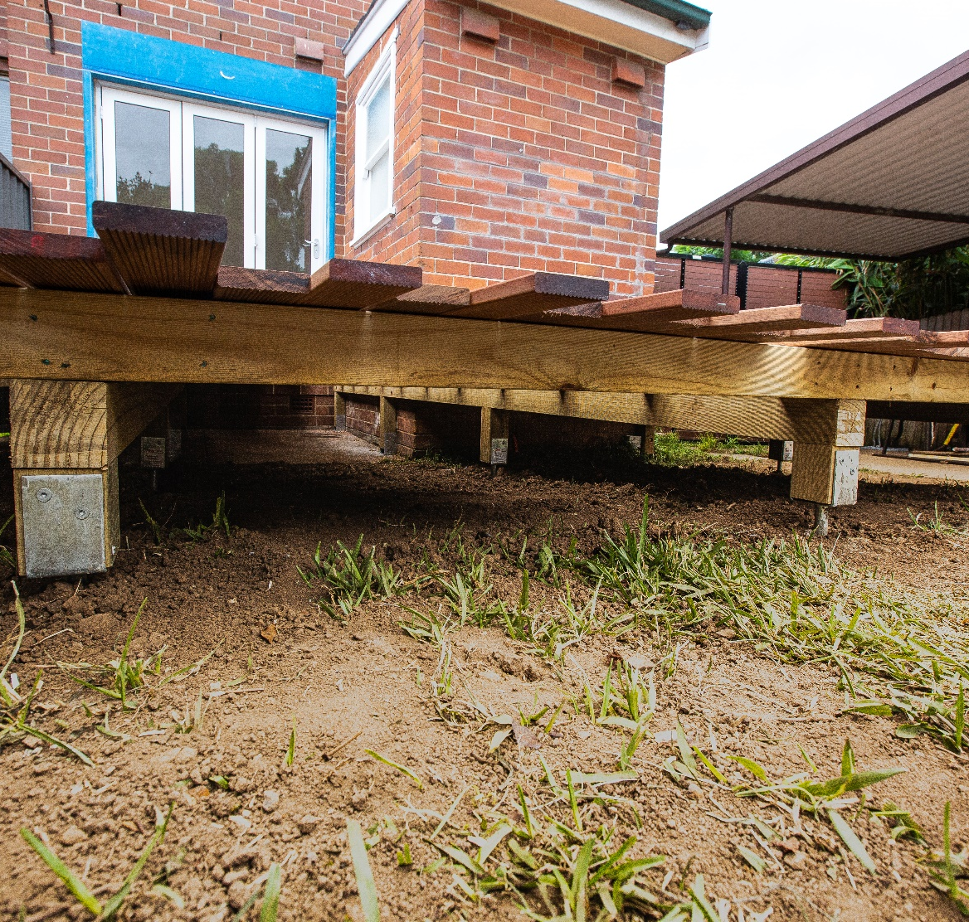
Where our review is up to
In our Draft Report we investigated the efficiency and effectiveness of the scheme including:
Impediments to private sector participation
Average premiums and claims
Unnecessary regulatory burdens for builders
April
2020
September
2020
29 September
2020
16 October
2020
November
2020
    Issues Paper
    Draft Report
    Public Hearing
    Public Submissions due
    Final Report
SUBMISSIONS
DUE

Slide 4

Draft findings and recommendations on impediments to new entry
New entry would increase product innovation and put downward pressure on premiums
  Legislative barriers to alternative indemnity providers, such as fidelity funds
  Duplication in prudential obligations for insurers increases entry costs
  Regulatory framework restricts how new entrants compete in the market
  Amend the Home Building Act 1989 to allow non-insurers to offer a discretionary product
  SIRA should simplify licensing for insurers
  Remove prescriptive requirements for SIRA to approve premiums, eligibility and claims models for new entrants in favour of a market monitoring arrangement

Slide 5
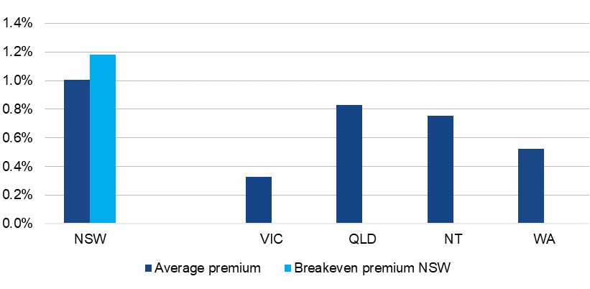
Draft findings on premiums and costs
Premiums are significantly higher than similar schemes in other states
NSW has fewer claims, but higher average claim costs than other states

Slide 6

Draft recommendations on premiums and costs
To better understand and reduce costs we recommend:
SIRA tracks and compares icare’s costs over time
icare publishes its premium calculator online
Making brokers voluntary

Slide 7

Draft recommendations on icare
icare should be subject to increased scrutiny
Sole provider of mandatory HBCF
Does not risk losing customers
Faces no competitive pressure to improve services and deliver them efficiently
  Aim is to provide outcomes that would be reasonably expected if there were competitors in the HBCF market

Slide 8
Draft recommendations on icare
An independent regulator should review and determine icare’s HBCF premiums
  so that premiums are sufficient and not excessive
  reflect reasonable expected claims costs and efficient expenses
SIRA should review and determine icare’s builder eligibility assessment process
  seeks information that is necessary and is weighted appropriately
  transparent in eligibility decisions incl. why conditions have been imposed
  resolves issues in a timely manner

